Slide 1
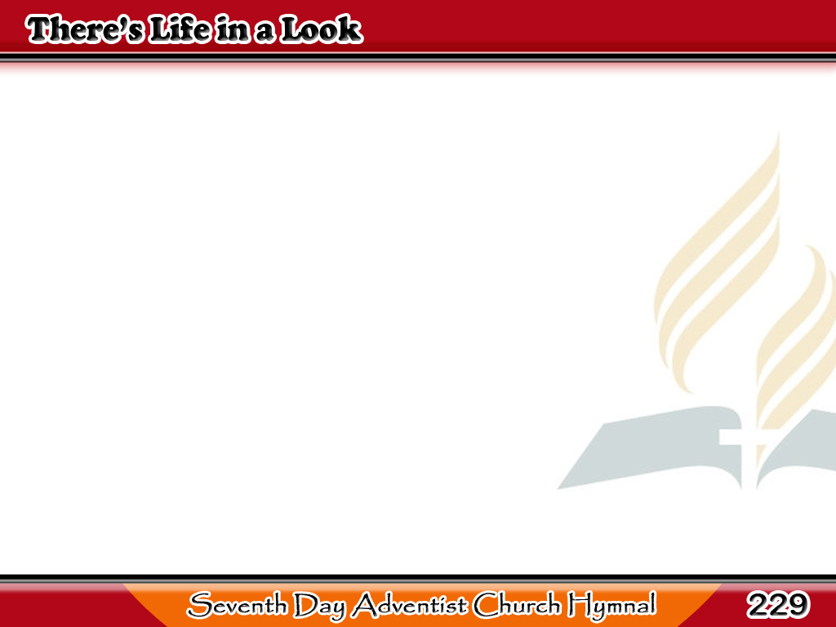
May Buhay sa Isang Tanaw Lamang
There’s life in a look
at the sacred cross,
Jesus has said,
“Look unto me;”
1/3

Slide 2
May Buhay sa Isang Tanaw Lamang
Earth with its riches
is only dross,
Bright treasures beyond
in the cross I see.
1/3

Slide 3
May Buhay sa Isang Tanaw Lamang
-Refrain-
In a look there’s life for thee,
In a look at Calvary.
Blessed thought, salvation free,
By a look at Calvary.
1/3

Slide 4
May Buhay sa Isang Tanaw Lamang
When first to the Saviour
I raised my eyes,
Sweet was the smile
that fell on me;
2/3

Slide 5
May Buhay sa Isang Tanaw Lamang
Oft as the clouds
of temptation rise,
A look at the cross
still my strength shall be.
2/3

Slide 6
May Buhay sa Isang Tanaw Lamang
-Refrain-
In a look there’s life for thee,
In a look at Calvary.
Blessed thought, salvation free,
By a look at Calvary.
2/3

Slide 7
May Buhay sa Isang Tanaw Lamang
I’ll look to the cross
ev’ry day and hour,
Trusting the promise
God has given;
3/3

Slide 8
May Buhay sa Isang Tanaw Lamang
None ever fall neath
the tempter’s pow’r,
Who trust and obey
in the strength of Heav’n.
3/3

Slide 9
May Buhay sa Isang Tanaw Lamang
-Refrain-
In a look there’s life for thee,
In a look at Calvary.
Blessed thought, salvation free,
By a look at Calvary.
3/3

